Slide 1
Comparing statistical representations
Numerical summaries of data

Slide 2
how to use Oak lessons

Slide 3
I can see that different statistical representations offer different insights into a set of data.

Slide 4
A pie chart (pie graph) is a circular graph where sectors represent different groups proportionally.
A bar chart (bar graph) is a graph consisting of bars visually representing the frequency of objects or groups.

Slide 5

Comparing statistical representations
Comparing pie charts and bar charts
Matching information between pie and bar charts

Slide 6
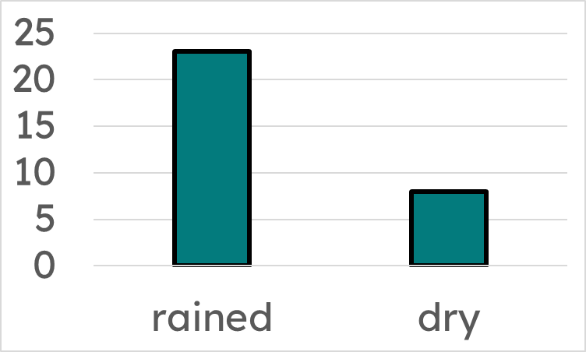
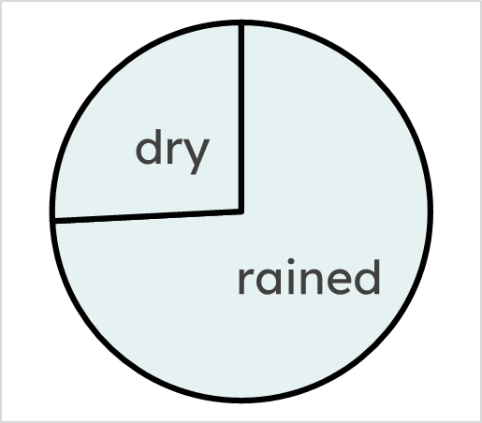
Comparing pie charts and bar charts
Both this pie chart and bar chart represent the same data set of:
“days it rained last month”.
Both bar charts and pie charts are used to visually represent data.
At a quick glance, they can both show key insights of the data set.
Which insights are more easily understood from a snapshot look at each type of chart?

Slide 7
Comparing pie charts and bar charts
A bar chart can provide quick insight into comparing between each subgroup of data.
“it rained around three times as frequently as it was try”
A pie chart can provide quick insight into comparing one subgroup of data against the whole data set.
“it was dry for just over a quarter of the days last month”

Slide 8
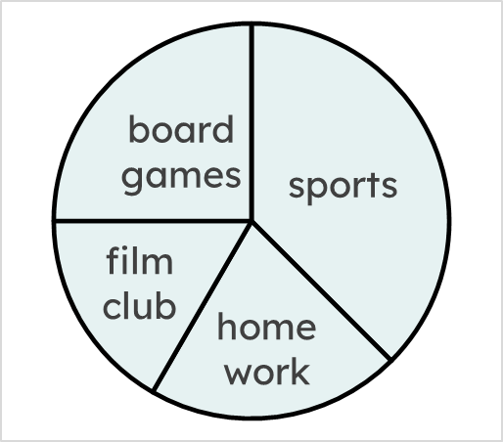
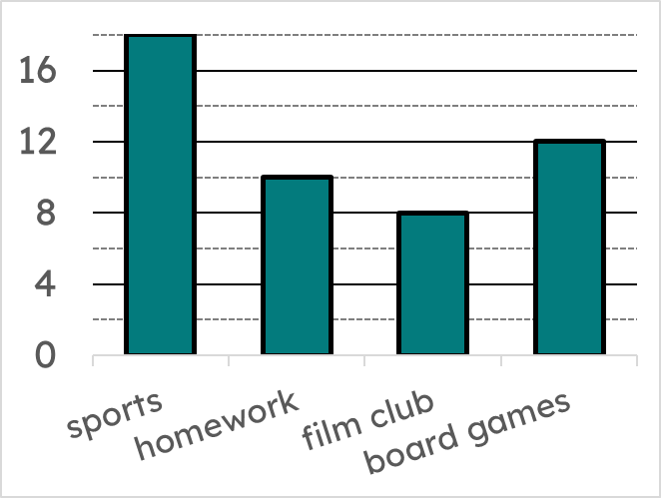
Comparing pie charts and bar charts
Both this pie chart and bar chart represent the same data set of:
“activities students did at lunchtime”.
From just a quick look at the two charts, can the bar chart, pie chart, or both, show you
what the modal activity was?
The modal activity is the activity with the highest frequency (the mode).
The modal activity was sports. You could answer this using both charts.

Slide 9


Comparing pie charts and bar charts
From a quick look, which chart shows you how many students attend a sports club at lunchtime?
Both
a
b
c
18 students attend a sports club. This could not be answered using the pie chart, because this pie chart does not include any frequencies.

Slide 10
Comparing pie charts and bar charts
From a quick look, which chart shows you which activity a quarter of students joined?
Both
a
b
c
A quarter of students did board games. We can see this clearly from the pie chart, without the need for calculations.

Slide 11
Comparing pie charts and bar charts
From a quick look, which chart shows you how many more students did homework than film club?
Both
a
b
c
Two more students did homework than film club. We can see this most clearly by looking at the bar chart and making one short calculation of 10 – 8 = 2.

Slide 12
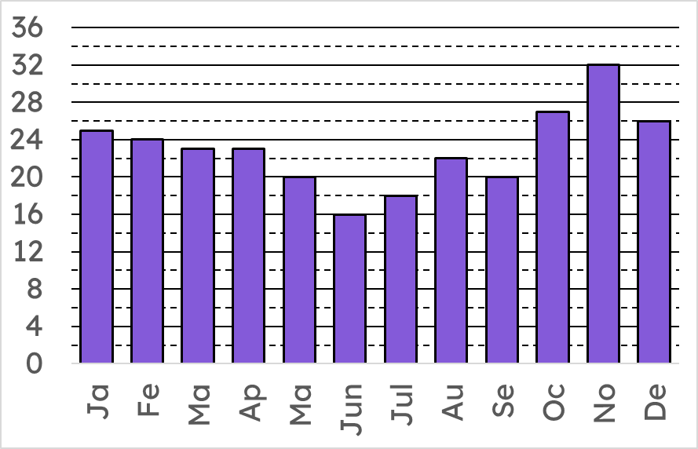
Comparing pie charts and bar charts
This bar chart shows the birth months of students in a school.
It is still possible to quickly gain insights from this bar chart, even though there are many bars.
What is the modal birth month?
November
How many students were born in February?
24 students
What was the least frequent birth month?
June

Slide 13
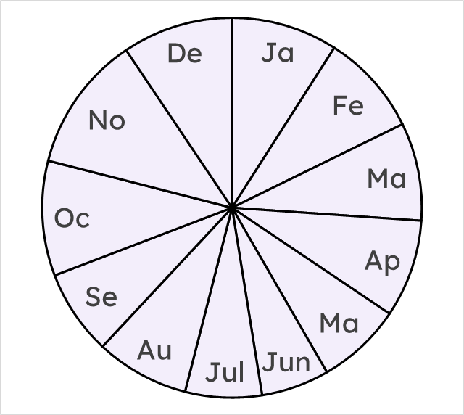
Comparing pie charts and bar charts
Some of the insights on this pie chart are hard to read quickly, as there are many sectors to consider.
What is the least frequent birth month?
June, but other months also look small.
How many people were born in October?
Without knowing at least one frequency and using a protractor, this is still tricky to find out.
This pie chart shows the birth months of students in a school.

Slide 14
Comparing pie charts and bar charts
This bar chart shows the birth months of students in a school.
However, some broader insights are still possible to read quickly.
Were more or less than 25% of students born in the winter months of November, December, and January?
More than 25%.
It is still fairly easy to see this from a quick look at the pie chart,
and still far easier than calculating it from this bar chart.
This pie chart shows the birth months of students in a school.

Slide 15
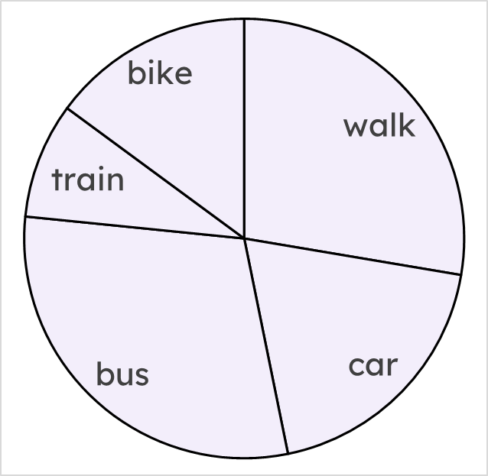
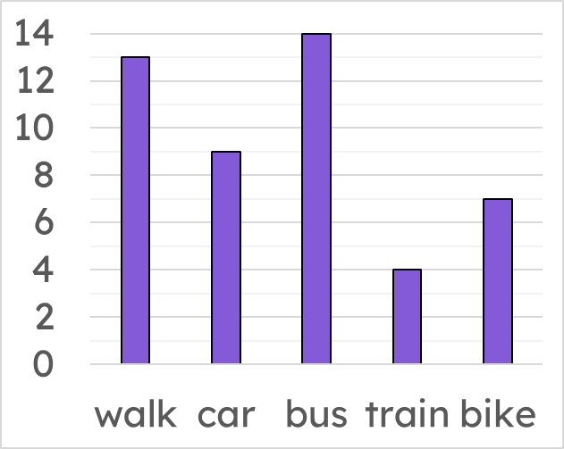
Comparing pie charts and bar charts
Both this pie chart and bar chart represent the same data set of:
“modes of transport to school”.
From only a quick glance at both graphs, answer these questions:
a) Did more than, less than, or equal to 25% of students walk to school?
b) With which graph (or both) is it possible to answer part a)?
More than
Pie chart (but it is possible to calculate this from a bar chart)

Slide 16
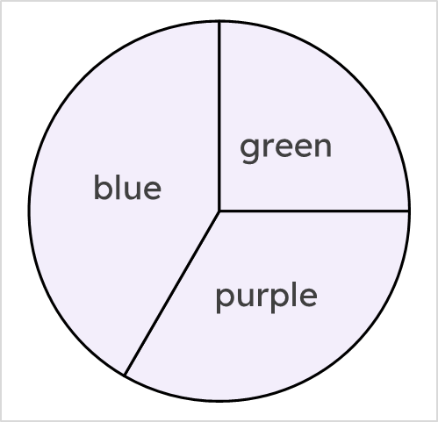
Comparing pie charts and bar charts
1) Tick the statements that are easy to determine from a quick glance at the pie chart.
a
Data were collected on a total of 288 students
b
A quarter of students voted green
c
120 students voted blue
d
The modal colour was blue
Pie chart showing students’ favourite colours.
Under half of students voted purple
e

Slide 17
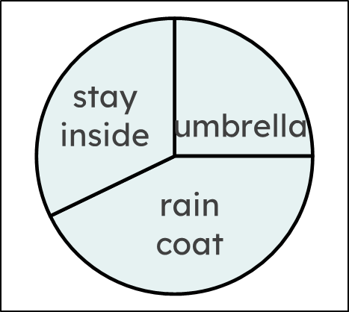
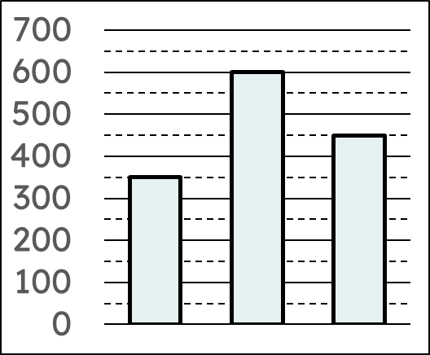
Comparing pie charts and bar charts
2) Both charts show “methods of staying dry”.
Answer each question in either the “pie chart” or “bar chart” column to show which chart you used to find the answer.
u
rc
si
question | pie chart | bar chart
a) What was the modal method of staying dry?
b) Which method of staying dry did 25% of people choose?
c) True or false: more than 50% of people voted raincoat

Slide 18
Comparing pie charts and bar charts
2) Both charts show “methods of staying dry”.
Answer each question in either the “pie chart” or “bar chart” column to show which chart you used to find the answer.
u
rc
si
question | pie chart | bar chart
d) How many more people voted for raincoat than umbrella?
e) How many people were asked in total?

Slide 19
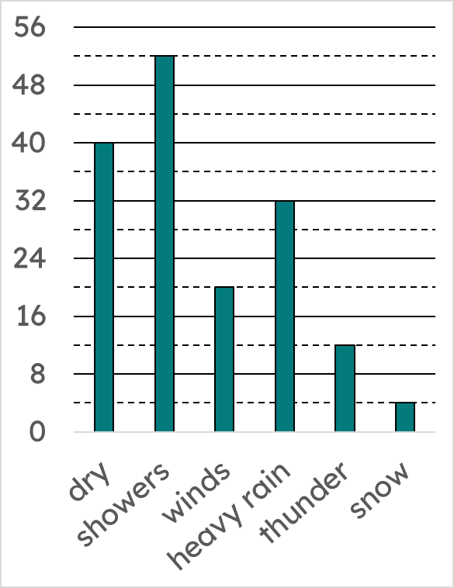
Comparing pie charts and bar charts
3) How easy are these questions to answer from the bar chart? Write Q for ‘from a quick glance’, S for ‘with a single calculation’, or M for ‘with many calculations’.
If possible, answer each question.
question | how easy to answer? | answer
a) How many days were dry?
b) What percentage of days had heavy rain?
c) How many more days was it windy than snowy?
d) What weather condition occurred 25% of the time?

Slide 20
Comparing pie charts and bar charts
1) Tick the statements that are easy to determine from a quick glance at the pie chart.
a
Data were collected on a total of 288 students
b
A quarter of students voted green
c
120 students voted blue
d
The modal colour was blue
Pie chart showing students’ favourite colours.
Under half of students voted purple
e

Slide 21
Comparing pie charts and bar charts
2) Both charts show “methods of staying dry”.
Answer each question in either the “pie chart” or “bar chart” column to show which chart you used to find the answer.
u
rc
si
question | pie chart | bar chart
a) What was the modal method of staying dry? | raincoat | raincoat
b) Which method of staying dry did 25% of people choose? | umbrella
c) True or false: more than 50% of people voted raincoat | false

Slide 22
Comparing pie charts and bar charts
2) Both charts show “methods of staying dry”.
Answer each question in either the “pie chart” or “bar chart” column to show which chart you used to find the answer.
u
rc
si
question | pie chart | bar chart
d) How many more people voted for raincoat than umbrella? |  | 250
e) How many people were asked in total? |  | 1400

Slide 23
Comparing pie charts and bar charts
3) How easy are these questions to answer from the bar chart? Write Q for ‘from a quick glance’, S for ‘with a single calculation’, or M for ‘with many calculations’.
If possible, answer each question.
question | how easy to answer? | answer
a) How many days were dry? | Q | 40
b) What percentage of days had heavy rain? | M | 20%
c) How many more days was it windy than snowy? | S | 16
d) What weather condition occurred 25% of the time? | M | dry

Slide 24
Comparing statistical representations
Comparing pie charts and bar charts
Matching information between pie and bar charts

Slide 25
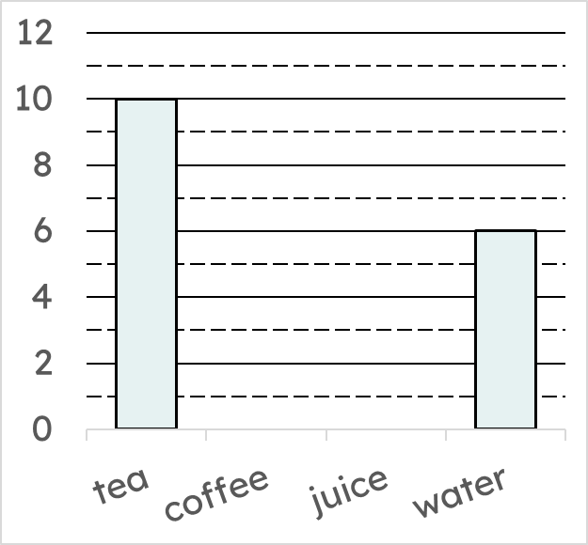
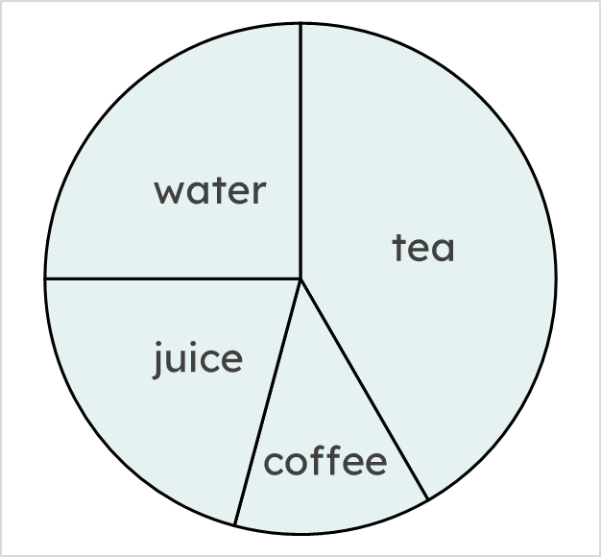
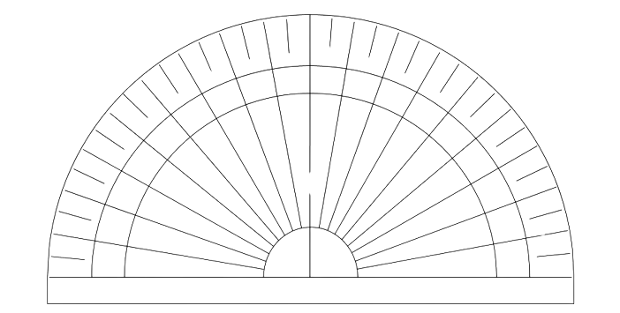
Matching information between pie and bar charts
This incomplete bar chart represents the same data set as this complete pie chart.
80°
70°
90°
100°
110°
60°
120°
90°
50°
130°
40°
140°
30°
150°
150°
20°
160°
10°
170°
75°
45°
0°
180°
Complete the bar chart.
Use a protractor to measure the size of some angles.
This will help you spot possible relationships between different subgroups.

Slide 26
Matching information between pie and bar charts
This incomplete bar chart represents the same data set as this complete pie chart.
90°
150°
75°
45°
Complete the bar chart.
Notice how coffee is half the angle of water.
This means that coffee on the bar chart will be half the height of water.

Slide 27
Matching information between pie and bar charts
This incomplete bar chart represents the same data set as this complete pie chart.
90°
150°
75°
45°
Complete the bar chart.
The same applies for juice being half the height of tea.

Slide 28
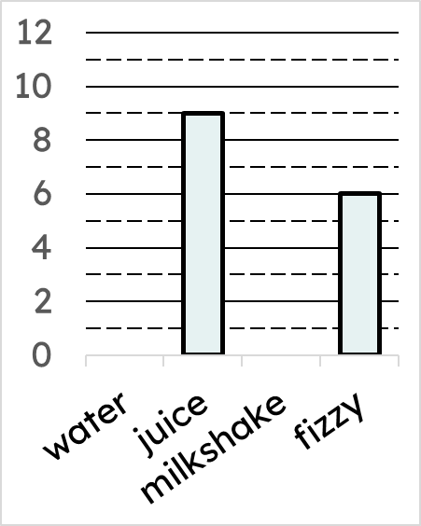
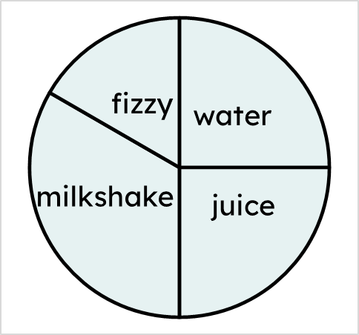
Matching information between pie and bar charts
Which two drinks were equally frequent?
water and juice
Both the pie chart and bar chart show a data set of “drinks students have in their lunchbox”.

Slide 29
Matching information between pie and bar charts
How many squares tall should the bar on the bar chart representing water be?
9 squares
Both the pie chart and bar chart show a data set of “drinks students have in their lunchbox”.

Slide 30
Matching information between pie and bar charts
The angles for milkshake and fizzy are measured.
How many squares tall should the bar on the bar chart representing milkshake be?
60°
120°
milkshake has an angle double that of fizzy
double 6 squares is 12 squares
Both the pie chart and bar chart show a data set of “drinks students have in their lunchbox”.

Slide 31
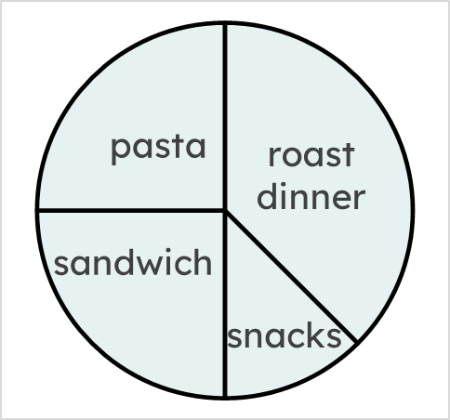
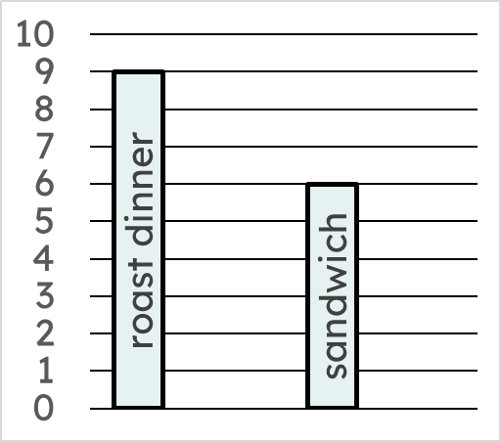
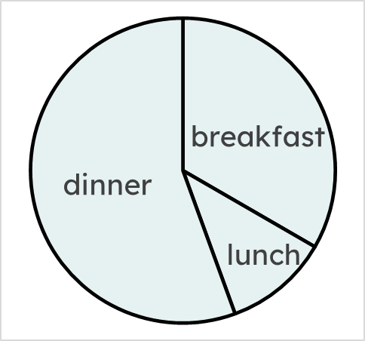
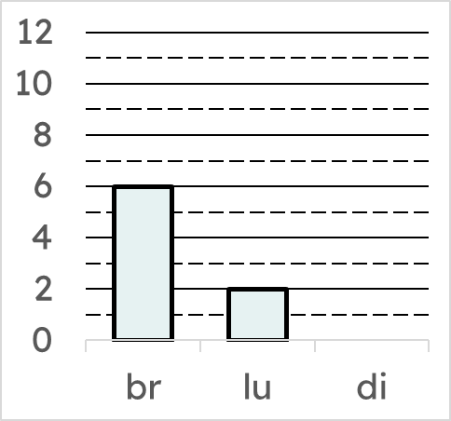
Matching information between pie and bar charts
1) Both the pie chart and bar chart show the same information about students’ favourite meals.
The angles on the pie chart have been measured.
200°
120°
40°
a) Using information from the pie chart, how many times more people voted for dinner than lunch?
b) Hence, draw the bar on the bar chart that represents the number of people who voted for dinner.

Slide 32
Matching information between pie and bar charts
2) Both the pie chart and bar chart show the same information about lunchtime meals students had one day at school.
a) Using information from the pie chart, draw the bar on the bar chart that represents the number of students who had pasta for lunch.
b) Use a protractor to measure the angles in the pie chart.
c) Hence, draw the bar on the bar chart that represents the number of students who had snacks for lunch.

Slide 33
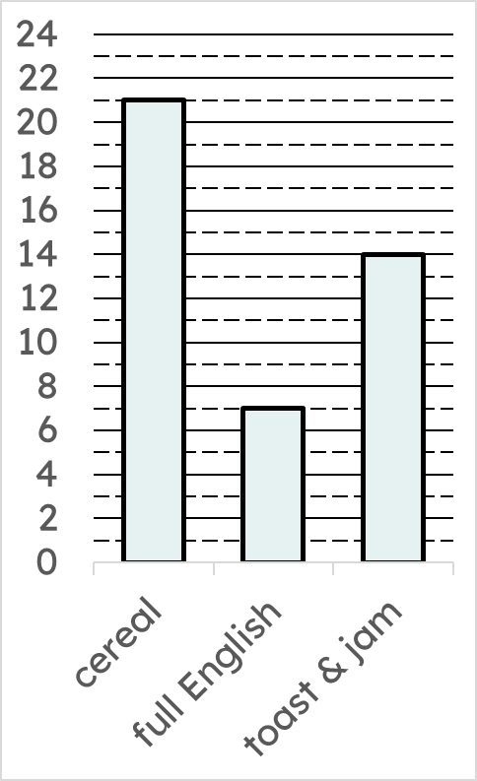

Matching information between pie and bar charts
3) Both the partially drawn pie chart and bar chart show the same information about breakfast meals students had one day at school.
By using the bar chart, complete and label the pie chart.

Slide 34
Matching information between pie and bar charts
1) Both the pie chart and bar chart show the same information about students’ favourite meals.
The angles on the pie chart have been measured.
200°
120°
40°
a) Using information from the pie chart, how many times more people voted for dinner than lunch?
five times more people voted dinner (200°) than lunch (40°)
b) Hence, draw the bar on the bar chart that represents the number of people who voted for dinner.

Slide 35
Matching information between pie and bar charts
2) Both the pie chart and bar chart show the same information about lunchtime meals students had one day at school.
90°
135°
pasta
90°
45°
snacks
a) Using information from the pie chart, draw the bar on the bar chart that represents the number of students who had pasta for lunch.
b) Use a protractor to measure the angles in the pie chart.
c) Hence, draw the bar on the bar chart that represents the number of students who had snacks for lunch.

Slide 36
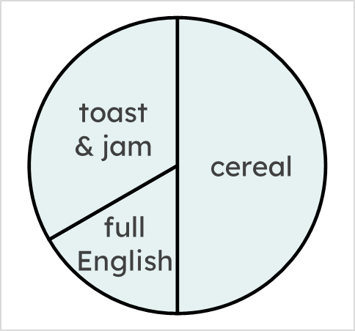
Matching information between pie and bar charts
3) Both the partially drawn pie chart and bar chart show the same information about breakfast meals students had one day at school.
120°
180°
60°
By using the bar chart, complete and label the pie chart.

Slide 37
Comparing statistical representations
Pie charts and bar charts provide different insights into data, and therefore should be used for different purposes.
Proportional reasoning of information from pie charts can be used to complete bar charts, and vice versa.
There are many effective ways of representing data beyond pie and bar charts, and there are features of each representation that make it useful.

Slide 38

© Oak National Academy 2023.
Produced in partnership with Mathematics in Education and Industry.
Licensed on the Open Government Licence v3.0, except where otherwise stated. See Oak terms and conditions.

